Slide 1
Sales Predictions
By: Michael Merenda

Slide 2
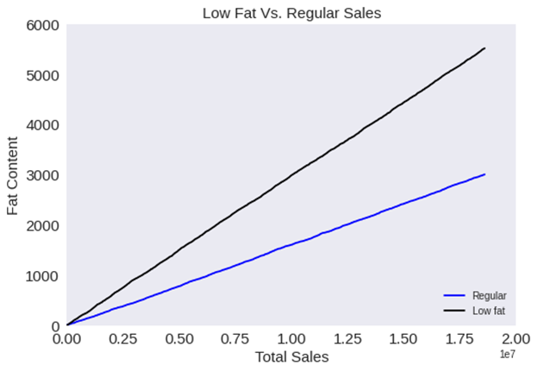
Low Fat vs. Regular Fat Sales
We can see that low-fat sales sell at a much higher rate than regular fat
Notes:
This Visualization showcases the comparison in sales between Low Fat and Regular Fat items in all Outlets. We can see that the low-fat products sell at a much higher rate than the regular fat items. This can mean that many consumers are choosing the healthier options. This also shows that the retailer should carry more inventory of low-fat items as they sell at a much higher rate than the regular fat items. Also, the retailer can start carrying more low-fat options of products they currently sell to increase sales

Slide 3
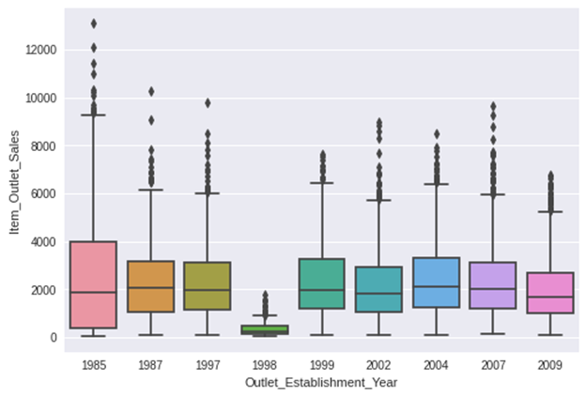
Sales Per Outlet Based on Year Established
Notes:
Another thing I analyzed was if sales were affected by by the age of the outlet. The boxplot above shows the amount of sales for each outlet broken down by the year the oulet was established. You can see that the oulets that were established in 1998 have the lowest sales among the rest. Even though the leasr amount of outlets were establsihed in 1998, it is very clear their sales are not at the same level as trhe other years. Now knowing this information we can focus on updating all outlets from 1998 to help increase their sales to meet the same or higher sales level than the other outlets.

Slide 4
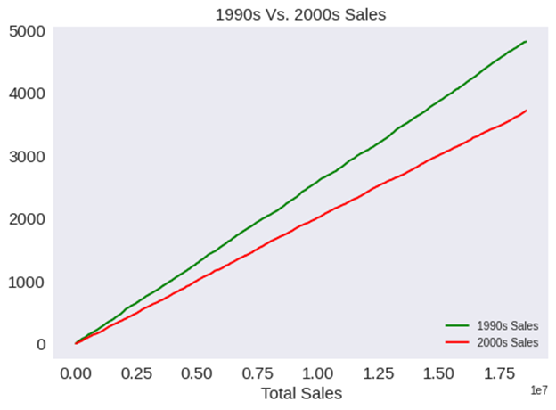
Sales Before and After 2000
We can see that Sales are higher in outlets established prior to 2000
Notes:
Next I explored how the sales from the outlets established in the 1990’s compared to the sales of outlets established after 2000. We can see that the sales prior to 2000 were higher. This can imply that a change was made in the Outlets, that had a negative affect on the consumer. This information will allow the retailer to investigate what changes were made in the stores around 2000 that could have had a negative impact on consumers.

Slide 5
Recommendations
Retailer can try carrying more low-fat options for existing items as they tend to sell better than the original option. Also, the retailer may need to research and adapt to the current health trends as it appears people are purchasing the healthier options.
Improve the outlets that were established in 1998 and update them to the same standard as the other outlets.
Investigate what changes were made to Outlets established after 2000 that may have had a negative affect for consumers as sales is higher from the older outlets.
Notes:
In conclusion, to improve sales, the retailer can try carrying more low-fat options for existing items as they tend to sell better than the original option. Also, the retailer may need to research and adapt to the current health trends as it appears people are purchasing the healthier options. Next the retailer can improve the outlets that were established in 1998 and update them to the same standard as the other outlets. Last the retailer can investigate what changes were made to Outlets established after 2000 that may have had a negative affect for consumers as sales is higher from the older outlets.

